Slide 1
Aging 101
A Guide to Aging, Services, and Supports in Ohio
[Insert logo here]

Slide 2
Aging 101
Ohio is home to the 6th highest population of older adults in the nation
Notes:
Ohio is home to the 6th highest population of older adults in the nation
Current Ohio stats (from Columbus Dispatch): according to census population estimates released in June 2019, 13 of Ohio’s 88 counties already had more people of retirement age in 2018 than they had children. In 2017 it was nine counties. In 2010, only Noble County in southeast Ohio had experienced what some call “the flip.”

Slide 3
Aging 101
Ohio Counties – The Flip
Ohio statistics – present and projected
A national phenomenon
Notes:
Projected Ohio stats:
Scripps heat maps of aging in Ohio counties
(From Cleveland Plain Dealer) The number of Ohio counties where there are more people 60 and older than there are residents under age 20 has grown from none in 2000 to what likely will be well more than half of the state in 2020.
In less than two decades, Older adults are projected to outnumber kids for the first time in U.S. history.

Slide 4
Aging 101
What is long-term care?
Long-term care can be a range of services and supports (LTSS) older individuals may need to meet their personal care needs.
The Place You Call Home
Types of Providers Within Long-term Care
Nursing facilities
Continuing care retirement facilities (CCRCs)/Life plan communities
Assisted living
Care can be provided in a range of settings, including;
Affordable housing, adult day, the home
Notes:
What is long-term care?
Long-term care can be a range of services and supports (LTSS) older individuals may need to meet their personal care needs. While it encompasses medical care, it also refers to assistance with the basic personal tasks of everyday life.
Some Types of Long-Term Care in Aging Services
Nursing facilities
CCRCs/Life-plan communities
Assisted Living
Care can be provided in a range of settings: affordable housing, adult day, the home, etc

Slide 5
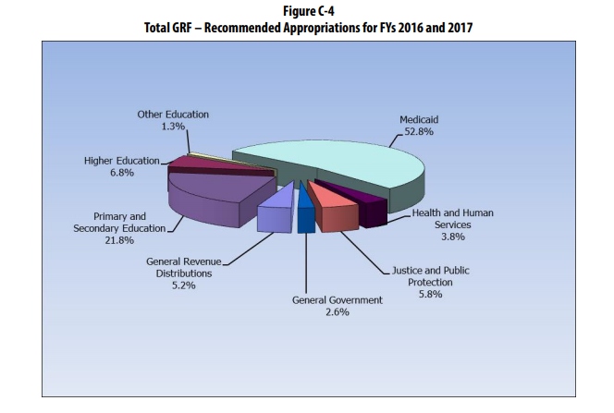
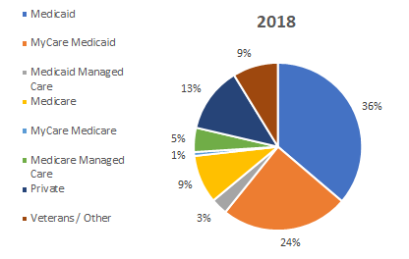
Aging 101
Who pays for care?
Funded through private dollars, insurance, or Medicaid – not Medicare.
Medicaid is paying for over 1/3 of Ohioans long-term care needs.
Medicaid is the top spend for the State of Ohio each budget cycle.
Notes:
Who pays for care?
Medicaid is paying for over 1/3 of Ohioan’s LTSS needs
Medicaid is the number one cost to the state of Ohio
Medicaid provides coverage for nearly 3 million Ohioans
LTSS reflects 5% of the state’s Medicaid enrollees yet 26% of spend in long term care costs
Yet, even with this, Medicaid doesn’t cover costs: typical LAO provider writes off hundreds of thousands (smaller single-site) to millions (large site or multi-site) each year
Medicare covers rehabilitation and end-of-life care but not LTC
Long-term care is funded either with an individual’s private dollars or under Medicaid
The resulting gap - some individuals may have planned to pay privately; the poor rely on Medicaid, but the middle class may become impoverished when the true cost of long-term care is experienced.

Slide 6
Aging 101
What is hospice & palliative care?
Hospice is a coordinated program of home, outpatient, and
inpatient care and services providing assistance to meet
physical, psychological, social, spiritual, and other special needs that are experienced during the final
stages of illness, dying, and bereavement.
Palliative care is specialized care for a patient of any age
who has been diagnosed with a serious or life-threatening
illness. This type of care can be administered to patients
still receiving treatment.
In 2018, Medicare was the payor for 94.8% of hospice care in Ohio.
Notes:
What is hospice & palliative care?
Hospice is a coordinated program of home, outpatient, and inpatient care and services providing assistance to meet physical, psychological, social, spiritual, and other special needs that are experienced during the final stages of illness, dying, and bereavement.
Palliative care is specialized care for a patient of any age who has been diagnosed with a serious or life-threatening illness. This type of care can be administered to patients still receiving treatment.
The majority of hospice care is provided in the place the patient calls “home”.
Private residences – most common (home care)
Long-term care facilities
Assisted living residences
In 2018, Medicare was the payor for 94.8% of hospice care in Ohio.
Medicaid – 3.7%, other – 1.6%
Hospices are not as capital intensive as some other provider types because they do not require extensive physical infrastructure.
Unlike long-term care, the Medicare payment adequacy indicators for hospice providers are generally positive.

Slide 7
Aging 101
The caregiver dilemma
The caregiver pool is shrinking, with less adult children staying in their hometowns to care for their aging family members.
Uncompensated family care provides the greatest percentage.
Notes:
The caregiver dilemma
The caregiver pool is shrinking - in 2010 there were 4.8 caregivers per person, but by 2030, there will be only 2.8 caregivers per person.
Greatest percentage of care is provided through uncompensated family caregivers.
Around 95% of unpaid caregivers are family members
2013: 40 million family caregivers provided 37 billion hours of care worth an estimated $470 billion to their parents, spouses, partners and other adult loved ones
Family caregivers provide approximately $500 billion per year in unpaid care, which is three times the amount that Medicaid spends for paid caregivers to provide long-term care services

Slide 8
Aging 101
Are Ohioans ready?
The Costs
On average, people turning age 65 over the next five years who ultimately experience high need LTSS can anticipate incurring costs over their lifetimes of approximately $138,000.
There is disparity by sex, health needs, and more.
Notes:
Are Ohioans ready?
The costs. On average, people turning age 65 over the next five years who ultimately experience high need LTSS can anticipate incurring costs over their lifetimes of approximately $138,000.
Disparity by sex. Cost for women’s care will be significantly higher ($180,000) than that for men ($90,000) – they experience more needs and live longer.
Disparity by health needs. 1 in 7 people will have long duration LTSS lasting 5 years or more and resulting in costs of $250,000 or more.
These numbers include all people over 65 whether or not they have LTSS needs. If only users of high need were reflected rather than all people over 65, the expenditures would double.

Slide 9
Aging 101
Are Ohioans ready?
The Resources
54% of middle-income seniors will not be able to afford annual costs of $60,000 for assisted living, independent living or other housing related costs even if they allocated all of their annual resources to such housing.
Notes:
The resources. 54% of middle-income seniors will not be able to afford annual costs of $60,000 for assisted living, independent living or other housing related costs even if they allocated all of their annual resources to such housing.
https://www.nic.org/middlemarket?utm_medium=email&utm_campaign
The health needs. Aging Ohioans are sicker and have a higher number of chronic conditions than many other states.

Slide 10
Aging 101
What is Ohio doing to prepare?
The Administration
The Ohio General Assembly
Evolving insurance models
Workforce Initiatives
Notes:
What is Ohio doing to prepare?
The Administration has sought to ‘rebalance’ where long-term care is provided --- reimbursing as much long-term care in the home as in institutional settings.
Institutional care is costlier both to the consumer and to the state.
Consumers typically prefer to receive care in their homes.
The General Assembly is working toward increasing payment incentives for providing higher quality outcomes in institutional settings.
Ohioans appear to be seeking additional insurance coverage - while LTC insurance has lost some momentum, hybrid life/LTC insurance is growing in popularity.
72,736: Number of hybrid life/long-term care policies sold to individuals, 2009.
305,068: Number of hybrid life/long-term care policies sold to individuals, 2013.
https://www.naic.org/documents/cipr_current_study_160519_ltc_insurance.pdf
Providers are adapting care models to better fit the needs of the baby boomer generation – more active, less institutional care.
Ohio’s Workforce Transformation office and educational institutions are partnering with providers to create new workforce initiatives
The longevity economy recognizes that business opportunities surrounding elders are growing.
Longer lifespans mean more opportunities for older adults to engage and stay active in their communities.

Slide 11
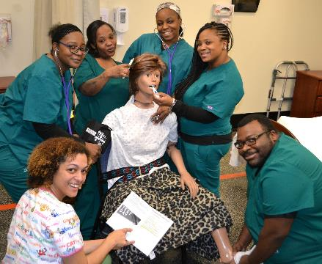
Aging 101
What kinds of aging services jobs are needed?
Over 21 different career paths within aging services, including:
Administration Transportation
Culinary Services and many more.
State Tested Nurse Aides (STNAs) are the frontline caregiver positions that are most in need among most aging services providers. STNA is the beginning of a potential pathway to higher certifications.
Notes:
What kinds of aging services jobs are needed in my area?
State Tested Nurse Aides (STNAs) are the frontline caregiver positions that are most in need among providers. This is often a first step towards a career in nursing and caregiving – many pathways upward.
A recent study showed that 60% of Ohio long-term care providers had no applicants nor qualified applicants for certain positions.
Almost all providers are hiring STNAs
Facilities need more registered nurses (RNs) and other positions across the clinical healthcare spectrum.
Long-term care providers also employ culinary and service staff, administrative positions, and many more (21 distinct careers have been identified in LTC)
Career that love you back

Slide 12
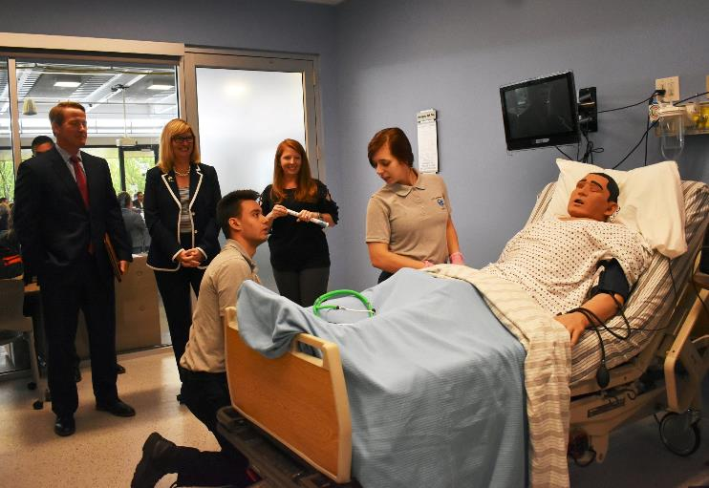
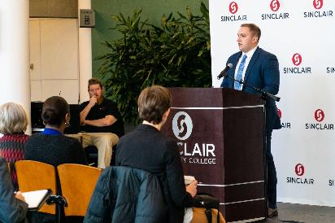
Aging 101
Workforce initiatives underway
Apprenticeships
11 community colleges around the state offer STNA apprenticeships – funded by the US Department of Labor
Notes:
Workforce initiatives underway
Providers are acting now to educate, recruit, and inform the workforce of tomorrow.
The Department of Labor now provides grant money for the state to implement an expanded apprenticeship program.
LeadingAge Ohio identified 11 community colleges to participate, offering students employment as they attend the class and a guaranteed job as an STNA once they finish their class.
Programs have been developed at Columbus State Community College, Lorain County Community College, Sinclair Community College, Edison State Community College, and Cuyahoga Community College.

Slide 13
Aging 101
Workforce initiatives underway
Careers That Love You Back
Notes:
The Careers That Love You Back campaign showcases 21 distinct career options in the fields of aging services and post-acute care.
Using a poster series, this program fosters an early awareness and interest in the field of aging services in K-6 grades, laying the foundation for later career readiness and training.
The examples vary across a full range of jobs and the program includes a teacher’s guide and instructions for approaching school districts served by members’ employees.

Slide 14
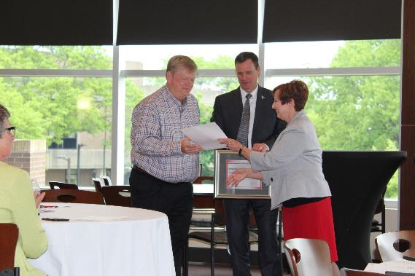
Aging 101
Workforce initiatives underway
Elder Care & Dementia Care Certification
Notes:
Ohio State has developed curriculum for an elder care and dementia care certification program for all students.
Currently offered to students at Vanguard-Sentinel Career & Technology Center in Tiffin in partnership with Good Shepherd Home in Fostoria
Pursuing expansion to career centers and high schools statewide as an intro into aging services.

Slide 15
Aging 101
Workforce initiatives underway
Outside-of-work supports
Employer Resource Networks
United Way Partnerships
Notes:
Employer Resource Networks (ERN®) foster business engagement and provide tools for employees to navigate challenges to their successful employment (transportation, child care, domestic abuse, payday shortfalls, and more).
ERN® program is working with LeadingAge Ohio as a partner to help foster growth across Ohio.
In some cases, county United Ways have been the facilitator of these outside-of-work supports.
LeadingAge Ohio provides Frontline Supervisor Training to share leadership principles and best practices that can be consistently applied by supervisors.
Provides a strong foundation to build a work environment that maintains respect, trust, and accountability.

Slide 16
Aging 101
What is
?
LeadingAge Ohio is a nonprofit trade association that represents over 400 long-term care organizations and hospices, as well as those providing ancillary health care and housing services, in more than 150 Ohio towns and cities.
The continuum of care reflected by the member organizations serve an estimated 400,000 elderly Ohioans annually and employ more than 35,000 persons statewide.
We provide advocacy support, professional education, and regulatory guidance to our members.
Notes:
What is LeadingAge Ohio?
LeadingAge Ohio is a nonprofit trade association that represents over 400 long-term care organizations and post-acute providers, as well as those providing ancillary health care and housing services, in more than 150 Ohio towns and cities.
The continuum of care reflected by the member organizations serve an estimated 400,000 elderly Ohioans annually and employ more than 35,000 persons statewide.
We provide advocacy support, professional education and regulatory guidance to our members.

