Slide 1

Next Steps Meeting to Explore State Level Actions that Foster LTSS Financing Reform
Notes:
This presentation is designed to support state level reform conversations for financing long term services and supports.

Slide 2
Background/Context for Meeting
LTSS Pathways Ohio—Composed of private and public cross-sector stakeholders convened in June 2016 to:
Review the national and state landscapes re: LTSS needs, costs, trends and budgetary implications;
Learn about potential federal responses;
Explore potential state-level responses;
Discuss interest in pursuing state-level action.

Slide 3
Establishing focus:
Over three meetings, the Ohio Pathways stakeholder group outlined the following priority focus areas for state level action:

Slide 4
Impetus for meeting: explore next steps
Focus on early wins that will advance education and increase uptake of LTC insurance protection
  What are actions we can take to move us forward in Ohio? (e.g. reduce inflation protection rates; increase education within employer settings; explore role of LTC Partnership product in achieving goals)
  How might we work together to shape and achieve early wins?

Slide 5
A framework for thinking together
    States hold a unique position and will likely be the most critical catalyst for creating the conditions that can help people prepare for and protect against LTSS costs.
    There is no one silver bullet. This challenge will best be met through a combination of small actions that cumulatively shift the landscape. Every step matters, so begin anywhere.
    (Olivia Mastry, Pathways facilitator)

Slide 6

Long Term Care Insurance
Considerations
Notes:
We learned a number of things from the modeling project

Slide 7
LTSS planning mental model barriers
LTSS planning/ options not integrated with other life planning
Life, health, savings and other planning
Notes:
Lastly, we isolate LTSS planning from any other type of planning that we do, separating it from life transition moments and employment benefit decisions when we are likely to make such decisions. This has a negative impact on uptake and planning.

Slide 8
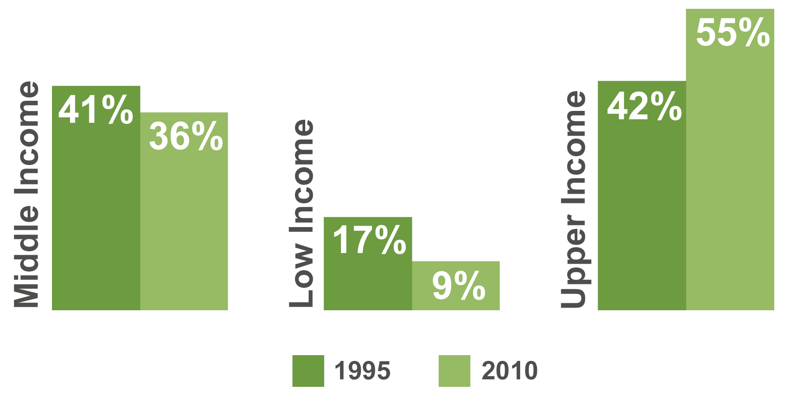
The middle class impact
The Share of LTC Sales to the Middle Market Age 40-69 is Declining
Notes:
There are fewer ways for middle income families to protect themselves financially given that private market insurance products are not affordable for them, these families are not eligible for Medicaid initially, and their financial assets are too limited to satisfy LTSS needs.
As a result insurance sales have only increased in upper income consumer brackets

Slide 9

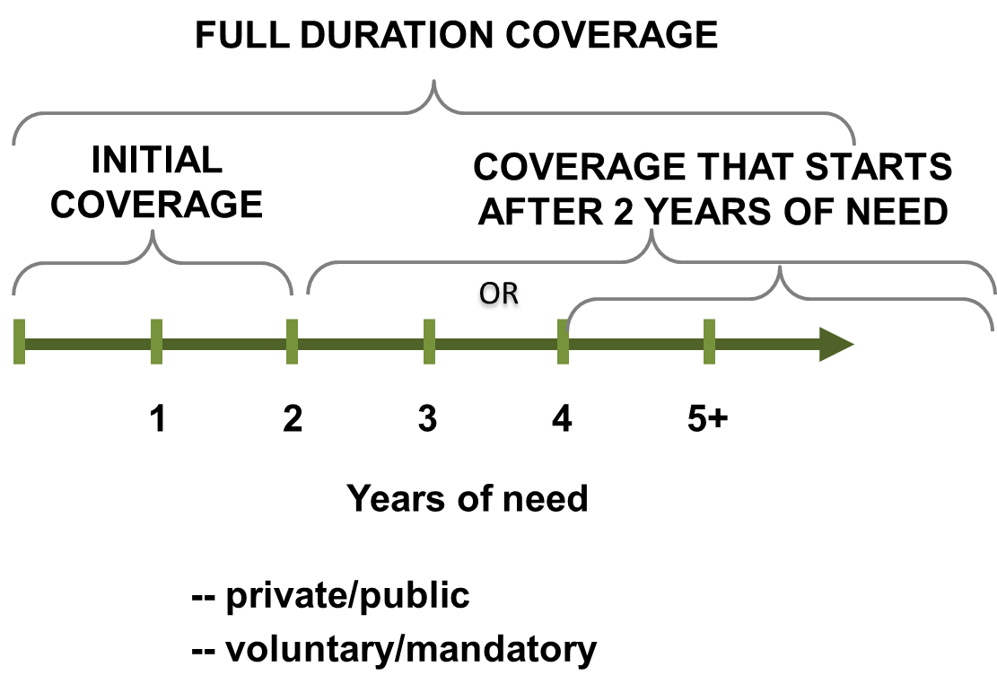


National modeling project
Funded economic modeling on 3 new options
COMPREHENSIVE
Notes:
To learn more about the impact of different LTSS financing options, LeadingAge, The SCAN Foundation, and AARP jointly funded an economic and actuarial analysis consistent with but not specific to the Pathways relating to the Private Market, Front-End, Catastrophic (back-end), and Comprehensive coverage options.
The modeling included three new insurance options, all with the same benefit structure.
Initial (front-end) coverage: Insurance that helps cover the first two years of a person’s services and supports expenditures once they have high need LTSS; this will address most people’s needs;
Catastrophic (back-end) coverage: For those with a long duration need, coverage that will begin after experiencing more than two years of high need LTSS;
Full duration coverage (comprehensive): Insurance coverage that will help pay LTSS costs from the beginning of a high-need LTSS situation through the duration of that need.
Each option was modeled as voluntary insurance and as a universal, mandatory program. Voluntary options included both subsidized and unsubsidized versions, with full subsidy occurring at 150% of the federal poverty line (FPL) or below and gradually phasing out at 200% of FPL.
All New insurance options had the following common designs elements:
$100 daily benefit
Cash versus re-imbursement structure
3% benefit inflation per year
Front end and Comprehensive had a 90 day waiting period;
Catastrophic had a 2 year waiting period
Front end 2 year benefit duration; others uncapped
Favreault M, Gleckman H, & Johnson R, Financing Long-Term Services And Supports: Options Reflect Trade-Offs For Older Americans And Federal Spending, Health Affairs, no. 2015. http://content.healthaffairs.org/content/early/2015/11/13/hlthaff.2015.1226.full.pdf+html

Slide 10
What Did LeadingAge Learn from the Pathways Project about New LTCi Options?

Slide 11
Modeling Caveats
Limited options were tested
Only high need LTSS
Only 65 plus
Lots of assumptions-little changes could have big impacts
Best use: directional as a starting point to guide discussion
Not as definitive as many hoped
Medicaid numbers are the shakiest
Notes:
The modeling analyzed three new insurance options (front-end, back-end and comprehensive benefits). Each option was modeled as voluntary insurance and as a universal, mandatory program. Voluntary options included both subsidized and unsubsidized versions, with full subsidy occurring at 150% of the federal poverty line (FPL) or below and gradually phasing out at 200% of FPL. The modeling used a consistent benefit set as described below:
A daily cash benefit of $100 that increases 3 percent per year.
Benefits can be used for both traditional and non-traditional services, such as paying family caregivers, purchasing transportation, or modifying a home.
Enrollees qualify for benefits if a health care provider certifies that they need help with two or more ADLs or have severe cognitive impairment, what we describe in this report as high-need level of LTSS, which aligns with the HIPAA benefit trigger for private long-term care insurance benefits.
The programs differ, however, by when benefits begin and how long they last. Enrollees in the front-end and comprehensive benefit programs must wait 90 days after qualifying for benefits to begin collecting, whereas enrollees in the catastrophic program must wait two years in one version and four years in a second version. Once they begin, benefits last for two years in the front-end benefit programs and for a lifetime in the back-end and comprehensive benefit programs.
Enrollee premiums would fund the voluntary programs, and a payroll tax would fund the mandatory programs. Like the current Medicare payroll tax (but unlike the Social Security tax), the LTSS tax would not be subject to a wage cap.
Adults 70 years and younger would be eligible to participate in the new programs and participation
Voluntary programs would require 50 percent higher administrative costs than mandatory programs
Participants would not be subject to underwriting, but, to limit the number of people with pre-existing disabilities who enroll in the voluntary program and drive up costs, enrollees in the voluntary programs could not qualify for benefits until they have paid premiums for at least five years, and participants in the mandatory program must have 40 Social Security covered quarters (about 10 years of work).
For mandatory programs financed through a payroll tax, the annual payroll tax is lowest for the 4 year waiting period catastrophic program (.48% of earnings or about $1,000 annually for a person who enrolls at age 45), followed by front-end (.64%/ $1240), 2 year waiting period catastrophic (.77%, $1910) and comprehensive (1.41%/$2400)

Slide 12
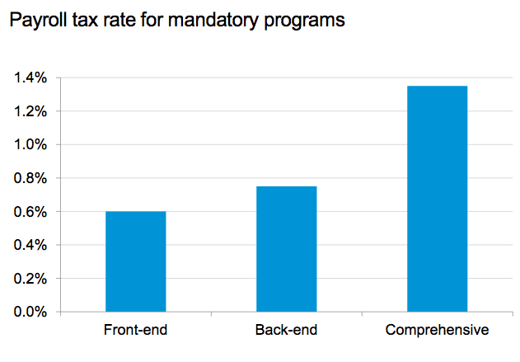
Most affordable options require participation
1.35%
.74%
.6%
Premium at $70k salary
$35/mo
$420/yr
$44/mo
$525/yr
$78/mo
$945/yr
Notes:
The modeling showed us investments needed to support options under an approach that requires participation

Slide 13
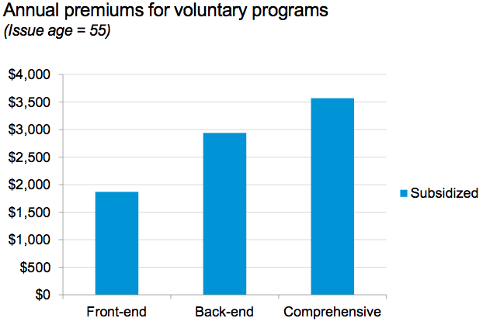
Voluntary programs are more expensive
Premiums for Voluntary Programs
Issue age 55
Premium at $70k salary
$156/mo.
$1870/yr.
$244/mo.
$2930/yr.
$289/mo.
3470 /yr
Notes:
Voluntary programs are much more expensive because fewer people enroll

Slide 14
New options ability to offset Medicaid costs
Millions
Notes:
The modeling also shows us that back-end/comprehensive coverage that begins after a person has 2 years of high need LTSS, will have a significant impact in offsetting Medicaid expenditures from 2050 on. In fact, the savings impact of the two-year back end option on Medicaid is almost equal to the savings of the comprehensive plan, at about half the cost. Two-year back-end coverage can also reduce out of pocket costs for families after their first two years of need. Front-end coverage will help to offset out of pocket costs during the first two years of need and provide an additional funding source to help finance unmet LTSS needs that up to now have placed an increasingly unsustainable burden on unpaid family caregivers.
Favreault M, & Johnson R, Microsimulation Analysis of Financing Options for Long-Term Services and Supports November, 2015, Urban Institute

Slide 15
New options ability to offset
OOP costs
Notes:
Front-end coverage will help to offset out of pocket costs during the first two years of need and provide an additional funding source to help finance unmet LTSS needs that up to now have placed an increasingly unsustainable burden on unpaid family caregivers. Two-year back-end coverage can also reduce out of pocket costs for families after their first two years of need.
Favreault M, & Johnson R, Microsimulation Analysis of Financing Options for Long-Term Services and Supports November, 2015, Urban Institute

Slide 16
An Ohio conversation

Slide 17
ODI INTRODUCTION TO PARTNERSHIP PRODUCT?

Slide 18
Possible options to consider in Ohio
Are there private market insurance options that could help people with out of pocket costs and offset Medicaid costs?
Could a refined LTC Partnership product serve in this role (limited dollar, comprehensive product)?
What other options might we explore?
Notes:
We will likely need a packaged approach to reach our intended impact. It needs to include an awareness/education component, offer realistic and affordable options, and activate people at a time when they are already thinking about other benefit decisions. It also must be combined with other reforms such as delivery innovation and rebalancing from institutional to HCB settings. Next steps for Pathways is to conduct more modeling about variations of the pathways and pursue reforms at federal and state levels.

Slide 19
The DRA Partnership product
Purpose: to increase the number of Ohioans who purchase insurance protection against the catastrophic costs of long term care so that, in the long run, few people will rely on public programs to finance their care
The partnership program has long-range policy objectives.
Notes:
Over the short term (e.g. for the first 10 years) the Partnership program was anticipated to have minimal impacts on both costs and savings to the Medicaid program.

Slide 20
Ohio’s Partnership product
Partnership program:
  Targets individuals and households of more moderate means than those who have heretofore purchased private long-term care insurance
  Goal: “… to increase LTCi purchase by those individuals who in the absence of insurance would deplete their financial savings and spend down to Medicaid”
  Goal: “Attractiveness of PQ insurance to persons of moderate means will decrease the number of persons sheltering and/or divesting assets to qualify for Medicaid”
Source: The Long Term Care Partnership Program: 5 Years After enactment under the Deficit Reduction Act.
17 October 2011. Thomson Reuters
Notes:
The PP is a policy tool designed to increase the number of person who pre-fund their long term care needs, thereby preserving Medicaid for those who truly need public assistance

Slide 21

Ohio’s Partnership product
Partnership Policies in Force by State
State of Issue | Frequency | Percent
Wisconsin | 49,134 | 13.5%
Minnesota | 35,549 | 10.0%
Florida | 35,211 | 9.6%
Texas | 30,814 | 8.4%
Ohio | 22,115 | 6.0%
30 Ohioan insureds in claim through same date
Source: The Long Term Care Partnership Program: 5 Years After enactment under the Deficit Reduction Act.
17 October 2011. Thomson Reuters. Table A-2. Reporting period ending June 30, 2011.
Notes:
Overall the short term (e.g. for the first 10 years) the Partnership program was anticipated to have minimal impacts on both costs and savings to the Medicaid program.
The PP is a policy tool designed to increase the number of person who pre-fund their long term care needs, thereby preserving Medicaid for those who truly need public assistance

Slide 22
Partnership Product Possible Changes
There’s no place like home
  Most long-term care services are provided in the home.
    Home care: 51%
    Nursing Home: 30.5%
    Assisted Living: 18.5%
Source: American Association for Long-Term Care Insurance, 2014 LTCi Sourcebook

Slide 23
Partnership Product Possible Changes (cont’d)
The costs for home care services have only been increasing at 1% over the past 5 years
  The national average for growth in both home health aide and homemaker services’ costs grew at just over 1%
  The five year growth in Ohio has been 1% over the past five years.

Slide 24
Homemaker Services
Hourly Rates
Region | Min | Median | Max | Median/ Annual Rate | Five-year Annual Growth
USA | $8 | $20 | $40 | $44,616 | 2%
Ohio | $16 | 19 | 30 | $43,564 | 1%
Akron | $18 | 19 | 20 | $43,472 | 2%
Canton-Massillon | $18 | 20 | 30 | $44,616 | 3%
Cincinnati | $16 | 19 | 22 | $44,341 | 0%
Cleveland-Elyria | $17 | 19 | 23 | $43,472 | 1%
Columbus | $17 | 20 | 24 | $45,760 | 1%
Dayton | $19 | 21 | 23 | $46,904 | 2%
Lima | $18 | 20 | 22 | $44,616 | 2%
Mansfield | $16 | 16 | 17 | $37,134 | n/a
Springfield | $19 | 19 | 19 | $43,472 | 2%
Toledo | $17 | 20 | 22 | $44,708 | 1%
Youngstown | $16 | 20 | 23 | $45,760 | 6%
Source: Genworth Cost of Care Survey 2015

Slide 25
Home Health Aide Services
Hourly Rates
Region | Min | Median | Max | Median/ Annual Rate | Five-year Annual Growth
USA | $8 | $20 | $40 | $45,760 | 1%
Ohio | $16 | 20 | 30 | $43,348 | 1%
Akron | $18 | 19 | 21 | $44,044 | 2%
Canton-Massillon | $18 | 20 | 30 | $44,616 | 3%
Cincinnati | $16 | 21 | 24 | $46,904 | 1%
Cleveland-Elyria | $17 | 20 | 23 | $45,188 | 1%
Columbus | $17 | 21 | 24 | $48,917 | 2%
Dayton | $19 | 21 | 23 | $48,048 | 1%
Lima | $18 | 20 | 22 | $44,616 | 2%
Mansfield | $16 | 16 | 17 | $37,134 | n/a
Springfield | $19 | 19 | 19 | $43,472 | 2%
Toledo | $17 | 20 | 23 | $45,554 | 1%
Youngstown | $16 | 20 | 23 | $45,760 | 5%
Source: Genworth Cost of Care Survey 2015

Slide 26
Partnership Product Possible Changes
A plan designed today with a 1% or 2% compound inflation option could keep pace with the historic increases in home care costs
Ohio lags behind other states
  At least 21 states now allow for 1% for all ages

Slide 27
Partnership Product Possible Changes (cont’d)
Premiums for a 55 year-old couple, male and female, showing the difference inflation rides can make
$170/day, 3-year total benefit*
1% Compound | 3% Compound | 5% Compound
$3,287.21 or $137/mo each | $4,941.50 or $206/mo each | $9,578.60 or $399/mo each
* Quoted in 2014

Slide 28
Partnership Product Possible Changes (cont’d)
Research indicated that these monthly price points boost purchase interest:
  Ages 45-51: $75/mo each
  Ages 52-58: $100/mo each
  Ages 59-65: $150/mo each
Of consumers who said they would not consider purchasing LTCi, 75% cited cost as the primary reason
When presented with newer lower cost approaches to plan design, consumer interest almost doubled overall, from 14% to 30% when compared to traditional plan designs.
  Among 45-51 year olds interest tripled from 11% to 36%
Source: John Hancock’s 2012 Study of Consumer Behavior – Factors that influence LTCi purchase decisions.
Conducted by Forbes Consulting Group in Fall 2012.

Slide 29
Partnership Product Possible Changes (cont’d)
Insurers may be tentative about issuing group PQ coverage
  Single-state employers may be more attractive
Opportunities for incentives for employers?

Slide 30
Partnership Product Challenges
Notification of potential claimants
Confused climate for LTCi sales
  Persuading buyers to purchase “short and fat” coverage vs. lifetime benefits
Notes:
“It is vital that individuals who are eligible for Medicaid asset disregard don’t fall through the cracks and fail to claim their asset disregard at the time they apply for medicaid.

Slide 31
LTCi
Possible Changes
Life to LTCi conversion product has gained interest of MN, for example
Adding non-medical home care to the Medicare supplement under consideration in MN, for example
Enhanced education for LTCi sales
Database changes for LTCi insured’s contacts

Slide 32
Generative Discussion
Which elements/proposed changes move the needle on creating acceptance of the partnership product?
What additional work is needed?

Slide 33
Package efforts for greatest effect
Public Awareness
Education Campaign and Call to Action
Responsive Options/Incentives
Offer People Options that Meet Initial and Catastrophic Need
Opportunity to Act
Incent Action and offer When People are Making Similar Decisions
Notes:
We will likely need a packaged approach to reach our intended impact. It needs to include an awareness/education component, offer realistic and affordable options, and activate people at a time when they are already thinking about other benefit decisions. It also must be combined with other reforms such as delivery innovation and rebalancing from institutional to HCB settings. Next steps for Pathways is to conduct more modeling about variations of the pathways and pursue reforms at federal and state levels.

