Slide 1
An Aging Ohio: Implications for Long-Term Services
Prepared for Committee on Aging and Long-Term Care, Ohio House of Representatives
Bob Applebaum
January 2020

Slide 2
An Aging Ohio-- 2000 to 2040– Ohio 6th Largest Older Population in the Nation
Year | 2000 | 2020 | 2040
Total Population (millions) | 11.4 | 11.7 | 11.7
60 plus in millions (% of total population) | 1.9 (17%) | 3.0 (25%) | 3.4 (29%)
65 plus in millions (% of total population) | 1.5 (13%) | 2.1 (18%) | 2.8 (24%)
85 plus in millions (% of total population) | .18 (1.6%) | .27 (2.3%) | .55 (4.6%)

Slide 7
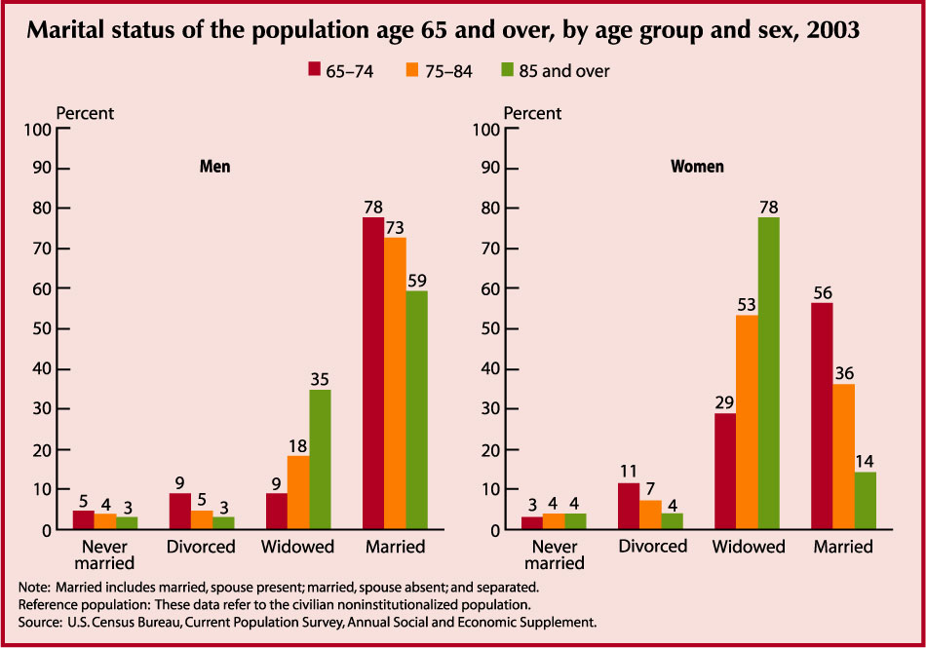
2010

Slide 8
National Retirement Income
Maximum Soc Sec benefit in 2019 is $3011
Avg. monthly Soc Sec benefit $1503
40% retirees rely primarily on Soc Sec
Less than half of today’s workforce has a private pension
Majority of older people do own their own homes (in Ohio 80%)
Median savings for 60-64 age groups in U.S.is about $15,000 Avg above $200K

Slide 9
Health Behaviors
Behaviors Ohio U.S. Rank
Smoking 10.6 8.7 41
Excessive drinking 6.0 7.1 19
Obesity 29.7 28 32
Physical inactivity 34.8 29.5 43
Frequent mental distress 6.2 7.3 11

Slide 10
Health conditions Ohio U.S. Ranking
Diabetes 24 22 38
Arthritis 57 52 44
Hip fractures per 1000 5.8 5.7 32
Falls (last 12 months) 28.8 29.5 16
Nationally-- higher in rural areas and higher for lower income elders

Slide 11
Ohio Health Use and Access 65 Plus
Health Access & Use % Ohio U.S. Ranking
Drug Coverage 89 87 1
Dedicated health provider 95 94.5 23
Low Care NH Residents 11.7 11.7 27
30 day Hospital Readmits 15.1 14.9 35
Preventable hospitalizations
(per 1000 admits, Medicare) 57 49.4 42

Slide 12
National Long-Term Services Numbers
7 million older people with disability– will more than double by 2040
Long-term services about one-third of Medicaid expenditures (Ohio 36%)
Medicaid about 22% of state budgets (Ohio 24%)
Two-thirds of residents now on Medicaid

Slide 13
Are Individuals Prepared for Long-Term Disability?
What is disability? Moderate-- shopping, getting to the doctor without help– Severe help with dressing or bathing
Will it effect me?
65 and older with some long-term disability 28.4%
65-74 20.2%
75-84 26.9%
85 plus 42.4%
Women higher rates than men
4% of Ohioans over age 40 have LTC insurance
Already talked about income and savings rates for older population

Slide 14
Family and Aging
Informal care provided an estimated $450 billion in long-term services
No time in history has more care been provided by family
But the world has changed– living longer, more two person working households, fewer children
Successful LTSS strategies almost always involve family

Slide 17
How Can Ohio Better Respond to the Growing Long-Term Services Challenges?
Unprecedented growth in the older population
Majority of Ohioans not prepared for a long-term disability either financially, environmentally, socially
Medicaid—the default for the majority of long-term service recipients.
Ohio’s older population is less healthy.

Slide 18
Policy and the Future
Even with changes the current system is simply not sustainable.
Short-term window where “boomer growth” remains small, before the major increase.
The current system was never designed-- it just happened– Meaningful change is very slow.
We often have policy changes with unplanned consequences. Hospital reform meant a new nursing home.

Slide 19
Strategies for Ohio
We need a range of solutions and an array of stakeholders to respond.
Individual level -- Responsibility for individual long-term planning
State Governmental examples– prevention programs, public/prvt partnerships
LTSS Provider examples—Identify strategies to improve effectiveness & efficiency
Business Community examples—Develop innovative technology, more flexible workplace
Local Community examples—Implement efforts to become a more age friendly community

Slide 20
Policy Recommendations for Ohio
Heavy pressure driven by Medicaid budget concerns– but most older people not on Medicaid (90%), Nationally and in Ohio-- Medicaid about 25% of state budget– Ohio -- 36% allocated to LTSS
Today 164,000 older people with severe disability– Almost half, about 81,000 on Medicaid.
In 2040, 310,000 older people with severe disability– if 50%-- 155,000 on Medicaid– not easily sustainable
Strategy needs to be to lower Medicaid use through prevention, individual planning, technology development, environmental adaptation.

Slide 21
Contact info
Bob Applebaum Applebra@Miamioh.edu
Scrippsaging.org (Scripps web site)

