Slide 1
Code Status
Presented by: Marsha Paul, MD Chief Medical Officer Hospice of Northwest Ohio and
Patsy Thompson, MD Physician Hospice of Northwest Ohio
Notes:
Today we are going to talk about the Code Status. The determination of a given patient’s code status is actually the culmination of a thorough goals of care discussion. Rather than jumping in with the mission to get that code status, we are hoping to show you a way that is better received by patients and care givers and allows the clinician to make custom tailored recommendations in line with the patients values.

Slide 2
Objectives
Smile at the history of resuscitation
Explore POLST – Physician Orders for Life Sustaining Treatment
Appreciate the Code Status Discussion as a Goals of Care Discussion

Slide 3
II Kings 4:34
Notes:
You may wonder looking at this slide, what does II Kings 4:34 have to do with a Code status talk. After a child of a Shunemite couple complained of a headache and died the profit Elisha “went up and lay upon the child, and put his mouth upon his mouth, and his eyes upon his eyes, and his hands upon his hands; and he stretched himself upon the child; and the flesh of the child waxed warm.” (2 Kings 4:34) “Where upon the child sneezed 7 times and open his eyes.” There you have it, the first successful attempt at resuscitation.

Slide 4
500-1500 AD
Notes:
Between 500-1500 AD, methods of resuscitation include flagellation, based on the mistaken belief that whipping deceased person would stimulate them back to life. Another early technique included rolling a victim over a barrel. Centuries ago, people realize the body became cold when lifeless any made the connection between life and heat. Consequently external heating in order to resuscitate a deceased person was attempted using methods such as warm ashes or hot water being applied to the body of the patient. Obviously these methods were not successful! And please to not try this at home.

Slide 5
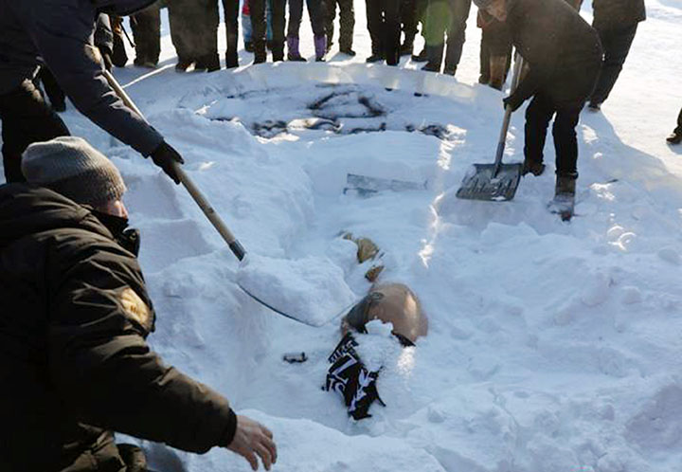
1500-1800
Notes:
In the 1500s a common practice was to take the tip of a bellow from a fireplace and place it in the patient's mouth and forced hot air into the lungs and in the 1800s they would bury the dying patient in ice in an effort to slow the metabolism. These were both unsuccessful but about 4 centuries later a bag mask unit with capacity to deliver 100% oxygen was developed. So it seem they were on the right track.

Slide 6
Trotting Horse Method
Notes:
Another curious technique is the “trotting horse method” It had some logic where the drowned or decised person’s body was straddled over the back of a horse and they would run the horse along the beach. The movement of the person's body as it bounced on the horse produced a form of alternating compression and relaxation. Believe it or not, this practice was band in the United States as a result of complaints from a group called, Citizens for Clean Beaches.

Slide 7
Dr. Safar - Father of CPR 1957
Notes:
The real revelation in CPR began in 1957 when Dr. Peter Safar performed a series of studies on his colleagues at John Hopkins University School of Medicine. Dr. Safar was an anesthesiologist. He administered a paralytic agent to his colleagues which of course paralyzed their muscles. He then demonstrated the effectiveness of mouth-to-mouth resuscitation. Can you imagine? I would not want to be his colleague! Dr. Safar was the 1st person to use the term the “ABCs of life support”- airway breathing and circulation. He coined the expression “cardiopulmonary cerebral resuscitation, CPCR. The phrase was subsequently shortened to CPR. Dr. Safar published “The ABCs of CPR” in 1957. Since that time, Dr. Safar has been considered the “Father of CPR.”

Slide 8
1960 Chest Compressions
Biomedical Engineer
John Hopkins University
1960 JAMA
“Anyone, anywhere, can now initiate cardiac resuscitative procedures. All that is needed are 2 hands. ”
Notes:
The next major breakthrough in resuscitation occurred in 1960 when a biomedical engineer at John Hopkins University School of Medicine discovered that external pressure on the chest was effective at restoring resuscitation. Subsequent experiments proved the effectiveness of closed chest cardiac massage in conjunction with artificial ventilation. Their findings were published in the Journal of the American Medical Association in 1960. They also stated, “Anyone, anywhere, can now initiate cardiac resuscitative procedures. All that is needed are 2 hands. ” Since that time in the 1960s the standards of care for basic CPR has changed in only minor ways.

Slide 9
Standards of Care - CPR
2010 Consensus Conference - 411 reviews, 277 topics
356 resuscitation experts
29 countries
evaluated, debated and discussed
36 month period
American Heart Association – every 5 years
Notes:
Professional organizations develop standards of care after considerable research and deliberation. For example when the American Heart Association modified the standards of care for CPR in 2010 it relied on 356 resuscitation experts from 29 countries who evaluated, debated and discussed the then current research over a 36 month. At the 2010 consensus Conference these experts generated 411 reviews covering 277 topics related to resuscitation and emergency cardiovascular care. Every 5 years the American Heart Association releases guidelines for the care of cardiac emergencies in adults and pediatrics. As providers we are obligated to follow the standards of care.

Slide 10
Patient Self-Determination Act
1990 Congress Enacted
Requires all healthcare providers/Medicare or Medicaid
All patients are asked about and advised of their right to execute an advanced directive
Healthcare facilities required to give
written information about healthcare decision making
Facility’s policy regarding patient wishes, including end of life decision making.
Notes:
Until 1990 there was no Federal statue or regulation recognizing a patient's autonomy in determining what shall be done if there is a cardiac arrest. In 1990 Congress enacted the patient Self determination act. Hospitals, home health agencies and skilled nursing homes that participate in Medicare or Medicaid must ask all patients if they have an advance directive and advise them of their right to execute an advanced directive. Healthcare facilities must give all patient's and residents written information about healthcare decision making as well as the facilities policies regarding patient wishes, including end of life decision making. Facilities are not to discriminate against any individual on the basis of whether an Advance directive has been executed or not. Every state recognizes an individual's right to have an advanced directive although procedural requirements may differ from state to state.

Slide 11
Use of Advance Directives
Influenced by age, race, health status and setting
Home health care patient 28%
Nursing home 65%
35% black, 70% white
Do not resuscitate is more common than living wills
Hospice 88%
Notes:
The use of advance directives seems to be influenced by several factors including age, race, health status and setting. Among home health care patients approximately 28% have advanced directives while 65% of nursing home residence have advanced directives. 88% of hospice patient's have advanced directives. Among the nursing home residents 35% of African American residents had advanced directives while 70% of White residence had an advance directive. The use of do not resuscitate orders were more common than living Wills nursing home residence.

Slide 12
Advanced Care Planning
CPT Codes
99497:
explanation
discussion
+/- form completion
Physician/qualified health professional
first 30 minutes, face-to-face; patient, family members and/or surrogate
99498 (add-on): Each additional 30 minutes
Notes:
Let’s talk a little bit about Advanced Care Planning Codes. These are times based codes There are two CPT codes for Advanced care planning. 99497 code is for the first 16-30 minutes and 99498 is for each additional 30 minutes. Advanced care planning includes the explanation and discussion of what advanced directives are and this may or may not include the completion of the forms. There are no limits to the length and number of times you can report the advance care planning CPT codes. The time reported must be spent in-person, face-to-face with the patient or surrogate. In addition, you must demonstrate in your note that the patient or surrogate was willing to have this discussion. You must also have start time and end time. Where should one keep their Advanced directives once completed? A copy with your lawyer, a copy at home, and a copy in the glove box of your care.

Slide 13
Limitations of ACP
Too broad or too specific
Aggressive measures
Resuscitation verses fluid resuscitation
Need clear and concise direction
Dynamic and easy to revise
Notes:
The limitation of advanced directives has been written about. They are either too broad or too specific to provide clear guidance to healthcare practitioners. Terms such as “aggressive measures” and heroic measures likely mean different things to different people and therefore lack clarity. Even the term resuscitation by itself is not precise. What if the only resuscitation is fluid resuscitation to return the patient to their baseline? Fluid resuscitation is a relatively benign form of treatment. Other terms such as extraordinary measures and unnaturally prolonging life are equally vague and subjective. Clear and concise directions are needed, such as, I do not want dialysis, or I do not want intravenous antibiotics. Another limitation to advanced directives is that the patient's end of life choices may change as his or her clinical condition, quality of life or values change. Therefore there is the need for patients to revise there advanced directives. Advanced directives should be thought of as dynamic rather than static documents.

Slide 14
POLST
Physician Orders for Life-Sustaining Treatments
Medical Order Form
Conversation – process- portable form
Person w/advanced frailty to make wishes clear
An extension of advance directives and DNR orders.
Notes:
MOLST=Medical orders for Life Sustaining Tx
COLST=Clinician Orders for Life-Sustaining Tx
MOST=Medical Orders for Scope of Tx
Began in early ‘90’s by group of medical ethicists who wanted to develop a tool to reflect specific wishes for people in last year of life. Encourages clinicians to have discussions w/pts near EOL regarding the specific tx’s they might want or not want as condition declines. Wishes are recorded on PULSE form that is portable and can remain w/both pt and practitioner but pt encouraged to keep form available in variety of health care settings so wishes are clearly known. Discussion and form cover much broader choices of medical tx’s than conventional advance directives and DNR forms.

Slide 15
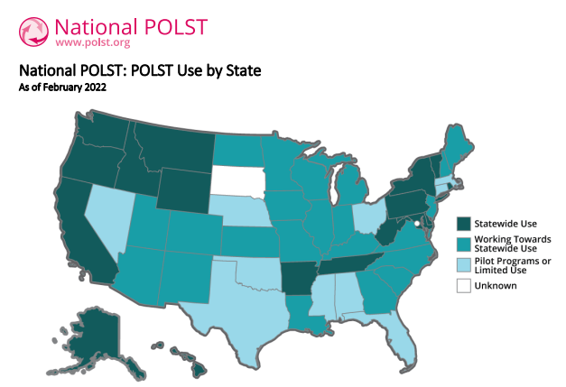
Medical institutions in states where the POLST form is not recognized have the legal right to recognize the POLST form within that institution.

Slide 16
POLST
May die within the next year
Nursing home or long term treatment
Want to avoid any life-sustaining treatments
Have 1 or more advanced chronic conditions and a poor prognosis
Had 2 or more unplanned hospitalizations in the last 12 months
Frailty, function, progressive weight loss, or loss of social support.

Slide 17
Portable Medical Order Form (POLST)
Resuscitation preferences
Respiratory support
Future hospitalizations/transfers to ER
Artificial feeding
Dialysis
Antibiotics
Other: transfusion of blood products, implantation of AICDs, pacemakers, etc.)
Notes:
-issues like resp support may go into more detail than what is typically addressed (i.e. Might include specifics like CPAP/BiPAP; bag valve mask, no resp support whatsoever)
-issues like nutrition/hydration may offer multiple options (i.e. No IV or artificial feeding of any kind vs a limited trial of IVF or artificial feeding vs long term artificial feeding/hydration)

Slide 18
POLST
The Medical Order Form reflects the patient’s wishes TODAY.
It is revisable and renewable.
Maintains a historical record of the patient’s wishes over time.
Historical document - helps loved ones understand the patient’s values and wishes.

Slide 19
Preconceptions About CPR
CPR knowledge base from watching TV.
TV Survival rates for in-hospital CPR are much higher than in actuality

Slide 20
CPR Survival Rates Compared
Actual Rates
>65 yo, 18.3% to discharge
Older men, non-white with lowest survival rates
All in-hospital cardiac arrests
17% to discharge
Cancer Patients
6.2% to discharge
Hematologic malignancies 2.0%
TV Rates
to discharge 50%,
men 2x the success rate as women

Slide 21
Ethics of CPR
CPR - potential to restore life
Does it make sense for everyone to have CPR at the time of death?
Effective vs Ineffective CPR
Questions to ponder:
Patient’s prognosis
Quality of Life
Burden of recovery

Slide 22
Legal Issues Surrounding CPR
Can a practitioner be sued for administering CPR against a patient’s wishes? (i.e. wrongful prolongation of life) YES!
Can a practitioner be sued for not administering CPR when there is not a valid DNR form? (i.e. wrongful death) YES!
Notes:
Wrongful prolongation of life-pt w/advanced directive but no valid DNR in an SNF was administered CPR in a case in FL. Paramedics are bound by state law to administer CPR if there is no valid DNR, so this case led to initiation of POLST forms.

Slide 23
Successful Code Status Discussion
Determine patient’s values/goals/hopes for the future - “what matters”
Over an expanse of time and under non-emergent circumstances.
A code status discussion should always be part of a larger goals of care discussion.
Should evolve as a natural “offshoot” of the Goals of Care conversation as opposed to a laser-focused discussion about code status.
Notes:
-Avoid going into conversation w/preconceived notion of what the pt’s choice should be; can’t really know what serves his/her interests before exploring what matters to them.
-Delicate conversations are always easier for pt if they are allowed to invite family/loved ones
-Set aside a fair amount of time, at least 15-20 minutes, make sure everyone involved can sit down and know they will be heard.
-Always a good idea to end conversations like this by asking “Is there anything else that you want me to know about you and what matters to you?”

Slide 24
VITAL GOALS
Priorities and hopes
ACTIVITIES
What do they want to do
LIMITS
Where is their line in the sand UNCERTAINTIES
Worries/Concerns
EXPERIENCE W/ ILLNESS
What is their experience with illness
STRENGTH/SUPPORT
What helps them get through
VALUES
Person-Centered Mapping Questions

Slide 25
VALUES Questions
“Knowing where your health stands now, what matters to you now and what do you want to prioritize in your life?”
“As you look forward to the next few months, what specific activities do you hope to be doing?”
“Can you imagine a situation where your life would not seem worth living?

Slide 26
VALUES Questions
“What worries or concerns do you have about the future?”
“Have you had any experiences with severe illness and how does that impact your thinking now?”
“What gives you support during difficult times?”

Slide 27
Goal of Care Scenario
Notes:
Mr. Simon is an 81 yo man with advanced Alzheimer's dementia. He has been hospitalized twice in the last year for urosepsis and aspiration pneumonia. He is confined to the bed and must be fed. He has contracture developing in his legs and a stage II pressure ulcer on his sacrum. His wife has done a marvelous job caring for him. Dr. Paul met with Mrs. Simon yesterday and is returning today to discuss his illness and goals of care. Despite optimal medical care the patient is becoming more hypoxic and medical team is afraid they may need to put him on the ventilator. Watch for the Values questions and the way the wife offers information about the patient. Notice how I do not have to ask ALL the individual values questions because the patient’s wife is giving me such expansive answers since she feels this is such natural and comfortable conversation. Often times in these discussions I do not have to even talk about the details of CPR before I can make a recommendation. It’s all about laying a compassionate and comfortable foundation for making these decisions.
Some of you may feel a little uncomfortable that I gave a recommendation regarding Mr. Simon’s code status. At our hospice and palliative care programs we now strive to make recommendations once we have explored the patient’s goal, values and priorities because we feel it is our professional responsibility. Remember the patient or surrogate can always decline our recommendation.

Slide 28
Conclusion
Code status conversations are goals of care conversations
Providers can make recommendations based on the patient’s values
POLST is a dynamic physician order that can better represent a patient’s end-of-life wishes

Slide 29
The communication skills materials featured are derived from VitalTalk (www.vitaltalk.org). These materials are used under direct permission from VitalTalk, and accordingly, may not be further distributed, copied, or otherwise used for commercial purposes without Vital Talk’s written consent.

