Slide 1
Important National POLST Updates
On January 25th and 27th, National POLST Stakeholders and the Board met to support and adopt a new direction and charter for National POLST.
  Transformation: Continue to advocate evidence-based best practices around use of POLST. Yet, respect the impact of differing state regulations. Focus more on the POLST process and eliminate the formal state review and credentialing program. Assistance will continue to be available regarding state program organization.
  Volunteerism: Meet goal of a large % of our funding directly impacting vision and mission achievement. We will count more on state leaders and stakeholders to work as volunteers with us to achieve this.
  We anticipate hiring a part time Executive Director by June 2023 with the hope that we can increase that position to full time in 2024.
Inclusivity: Our organization is newly renamed the National POLST Collaborative to reflect a focus on how we can achieve progress working together at the state and national levels.
Stewardship:
We are committed to creating a resilient, adaptable organization, sustaining and increasing the enduring impact of POLST.
This means building a more sustainable financial support model that will contain grants, donations and giving, educational programming and a membership program.
New Email Contact: natlpolstcollaborative@gmail.com
Currently, this email will be received by the National Executive Director, Kim Callanan.
Notes:
Becky slides 1-12

Slide 2

Ohio ACP/POLST Pilot: Mercy Health
Rebecca Gruszkos, LCSW, ACHP-SW
Director Advance Care Planning
Respecting Choices® AS Senior Instructor
Tammy Kill, MSN, RN
Program Manager ACP, Acute
Respecting Choices® AS Facilitator
Diane Lee, LSW, LNHA, MPH
Program Manager ACP, OH/KY
Respecting Choices® AS Instructor
*Update 2/22/23

Slide 3












Pilot Highlights
In Lima: Local SNF Group → HCF Management, Inc. → One facility is our 1st pilot site
Proposed by local physician leader during COVID response period
Started as Advance Care Planning Pilot → Idea to include POLST came later
BSMH | SNF | TRANSPORT COMPANIES | ED | INPATIENT | Rehab? | COMFORT/ PALLIATIVE?
Cross Continuum Goals / Stakeholder Engagement / Education

Slide 4
Timeline
Honoring Wishes Task Force decision to pursue “community standard” approach that is driven by health systems and community partners rather than revisiting legislative route in OH.
Original ACP Pilot grant funding renewed to extend through 2023 Decision to in OH.
Updated Local ACP Policy to include POLST
End-User Training Blitz
2021
2022
2023
Launch
BSMH POLST pilot in Lima approved
Designed Implementation Plan for OH &
Scheduled Launch for spring 2022
(Delayed to Oct ‘22)
*RC AS Facilitator Training in July
*Respecting Choices Advanced Steps Facilitator Certification Training: REQUIRED for non-providers to facilitate conversations around POLST and to prepare POLST forms

Slide 5
Preparation
→ Engage Stakeholders: Mission & Ethics
→ VP Operations, Legal, Risk

Slide 6

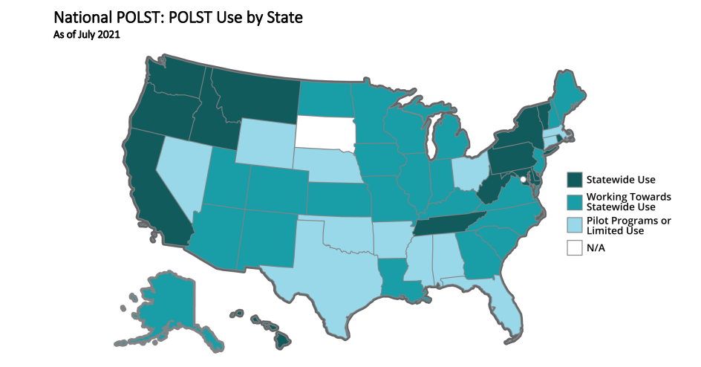
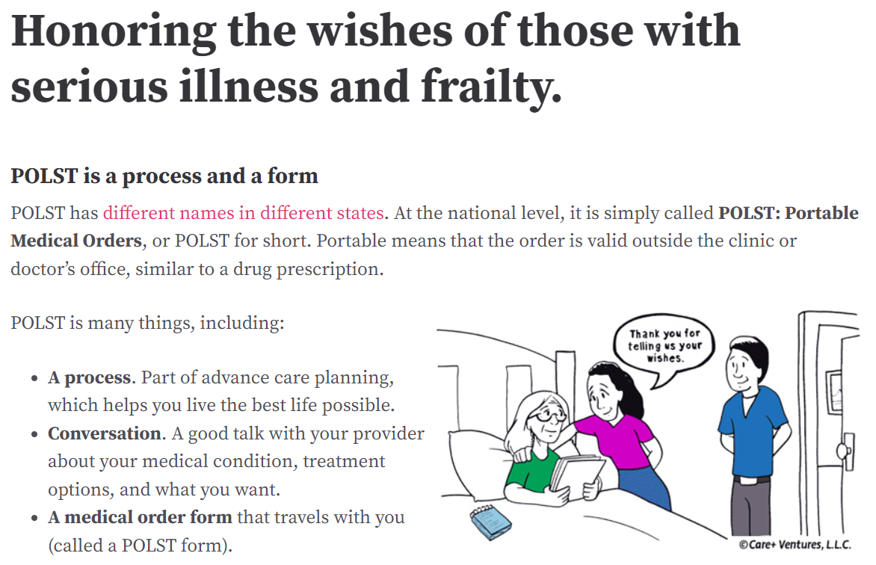
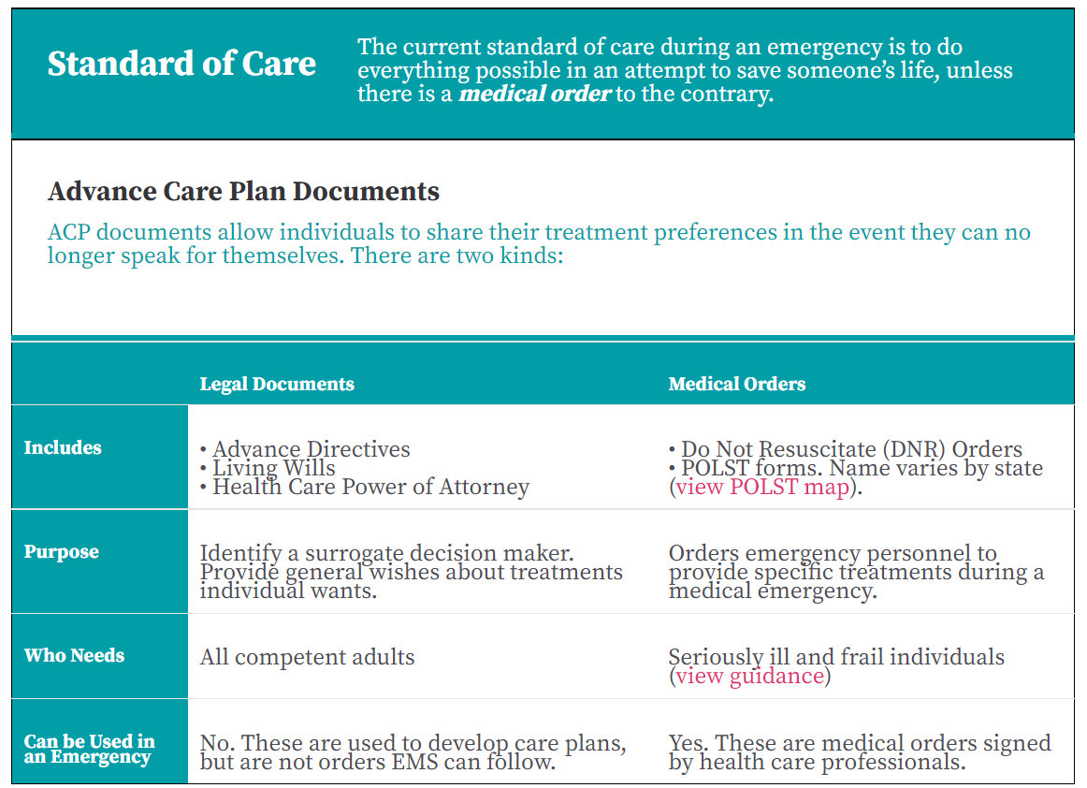
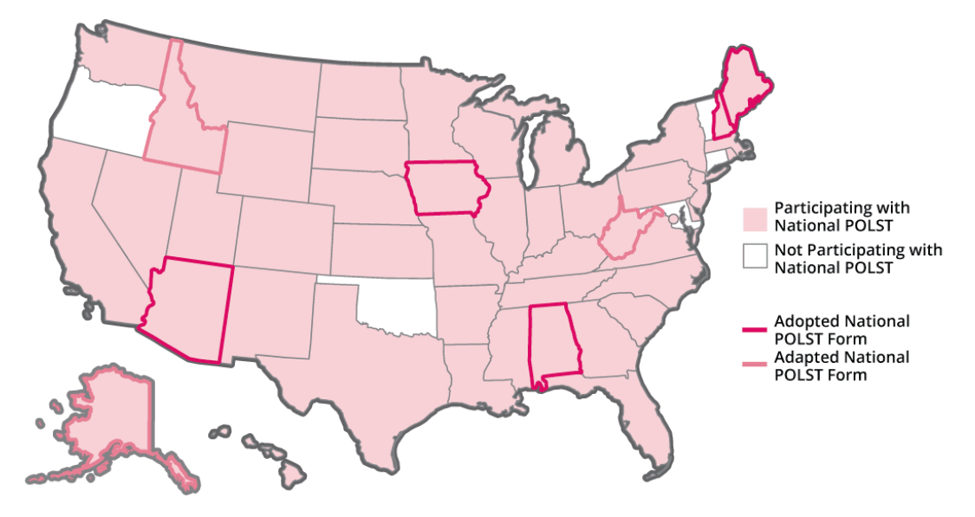
Shared Intro to National POLST:
Website & Messaging
National POLST Form Adoption

Slide 7
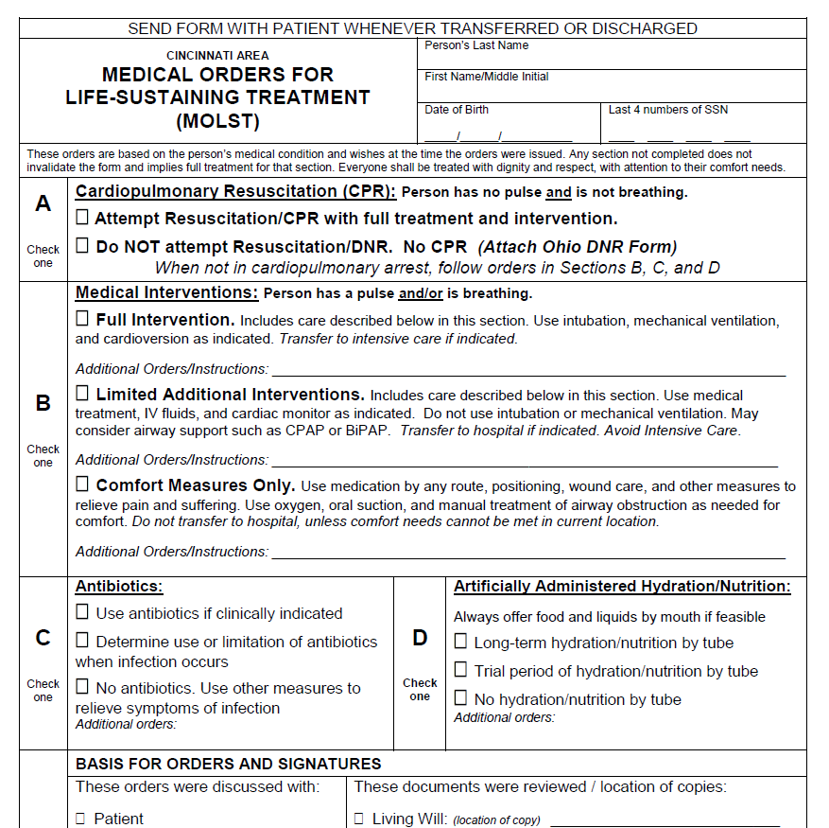
(Previous Form)
Cincinnati Area MOLST

Slide 8
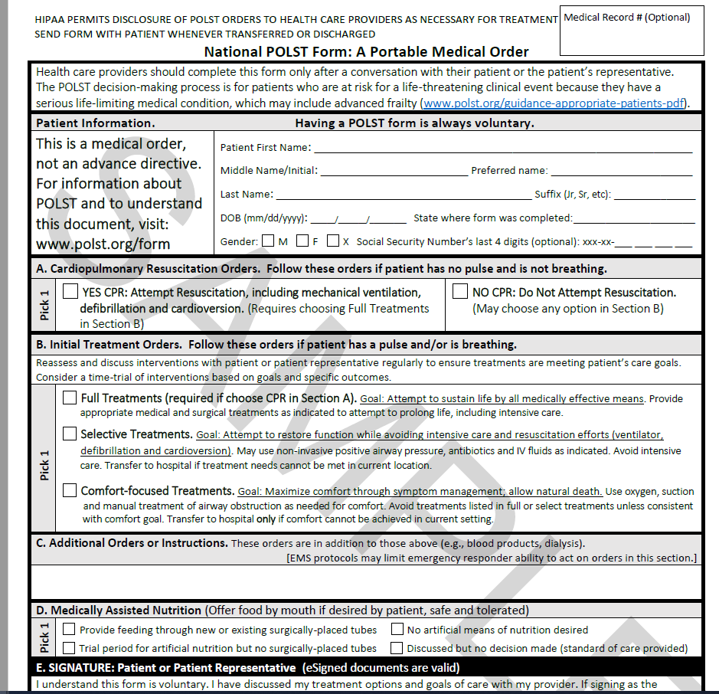
National
POLST

Slide 9
What POST is NOT
POST is NOT affiliated with “Death with Dignity Programs” that deliberately end life.
Position Statement released September 18, 2015
Notes:
Some people want to know if this is related to death panels, Obamacare, or the “death with dignity” movement. It is NOT.

Slide 10
What POST is NOT
The National Physician Orders for Life-Sustaining Treatment Paradigm recognizes that allowing natural death to occur is not the same as providing a lethal prescription to intentionally cause death. Neither the POLST Paradigm nor any POLST Form allows for PAS or PAD, nor does either authorize a health care professional to prescribe medication that would intentionally shorten life.
POLST originated in Oregon in 1991. The Death with Dignity Act passed as a ballot initiative in 1994. The programs developed completely independently of each other by different groups with different goals.

Slide 11
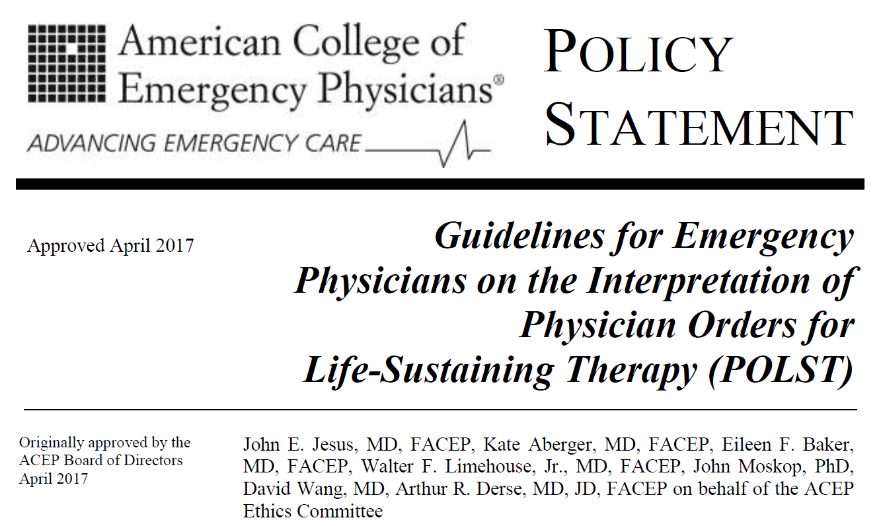
Challenges with DNRs & Advance Directives: Wording too vague or value based to apply to specific condition encounters. Result→ Emergency Physicians may in good faith initiate or withhold treatments that are contrary to a patient’s wishes.
POLST:
Promotes patient autonomy by documenting treatment preferences and converting them into medical orders
Facilitates appropriate treatment by EMS
Is not intended to replace a LW or HCPOA
Is intended for use with seriously ill or frail patients who have an advanced or progressive life-limiting illness.

Slide 12
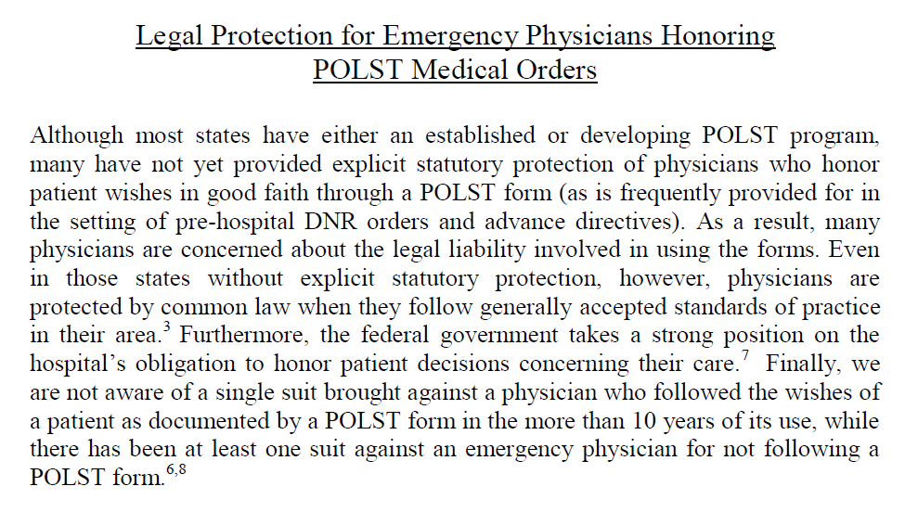
Specific, consistent wording helps

Slide 13
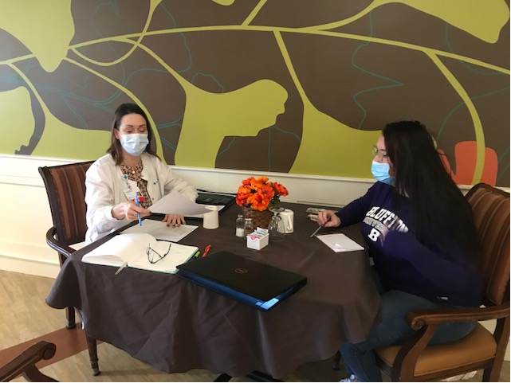
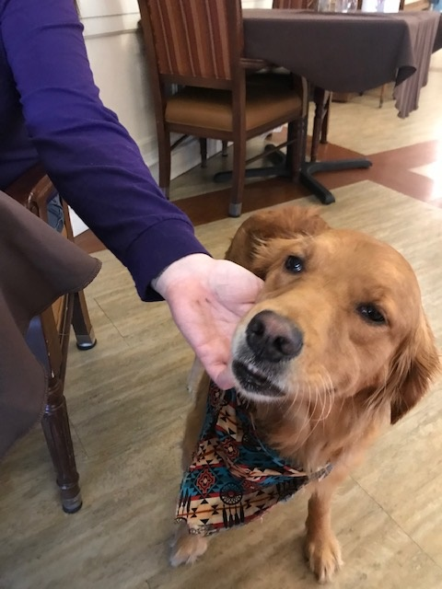
At the Same Time…
Pilot’s Physician Lead informed SNF leadership of POLST being added to ACP Pilot
HCF Corp. Director of Clinical Services
Partnering with Site’s Admin., DON, & SW
→ SNF Administration’s perspective? Positive!
Diane made site visit ☺

Slide 14

Next:
End-user Trainings

Slide 15
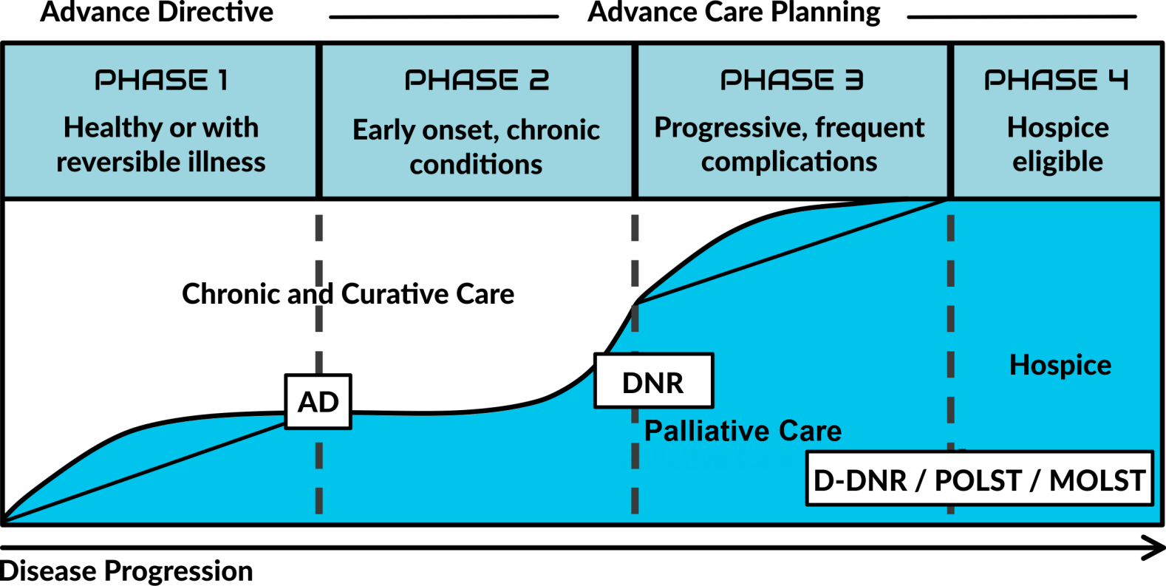


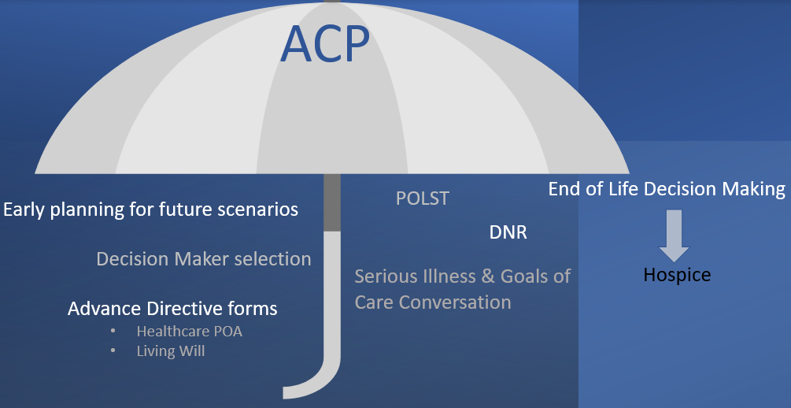
ACP Continuum
POLST: Physician orders for life sustaining treatment
MOLST: Medical orders for life sustaining treatment
Source: AHA CPI Analysis, 2012, with contributions from 2012 CTAC
data And 2011 Center to Advance Palliative Care data.
Notes:
Here you see the progression of advance care planning over time. The white portion of this image represents standard medical care for reversible or stable, chronic conditions. As we move left to right, notice that while curative options are exhausted over the course of an illness, palliative interventions are increasingly beneficial. Along this trajectory, the continuum of ACP unfolds as well. Ideally, medical decision making begins (click with the arrows) here when there is more time for reflection and discussion. Advance directives are the first important step. As a patient’s health declines, conversations become more specific around interventions, goals of care, and orders.
Unfortunately, ACP often starts (click with the arrows) here, when the patient has lost capacity or is too sick and the family is exhausted.
Another conceptual model (click with the arrows) shows us that ACP includes each of these items, but also illustrates that ACP is to occur prior to end of life.
Next Slide

Slide 16

Who is Participating in the ACP Pilot?
SNF Facility
Mercy Health – St. Rita’s – ED, Case Management, Nursing, Social workers, Spiritual Care
Lima Memorial
Transport Services
Hospice & Palliative Care – agency of patient choice
Bon Secours Mercy Health Advance Care Planning Team
Notes:
Angela
Read Slide
Next Slide

Slide 17
ACP
Facilitator
ACP
Coordinator
Has received training in having discussions with patients and POA’s about preferences for
End-of life care
Training was based on our POLST form
The Advance Care Planning process takes about 45 minutes and often involves follow-up and/or additional sessions
It is important that POLST form is not just a check off sheet---an ACPF can make sure people know and understand their options
Angela Keas BSN & Tammy Kill MSN
Both Respecting Choices Advanced Steps Certified
Facilitator SW – ACP Coordinator
Identify appropriate patients for ACP and for POLST to be utilized
Communicate with the ACP/Pilot team
Support patients and families in directing them towards ACP at admission and with transferring patients
Coordinate ACP conversations for facilitator with case conferences
Notes:
Tammy
You may be wondering what is my role in the ACP/POLST process?
Here at Shawnee Manor we will have an ACP Facilitator – only an ACP facilitator is certified to have the ACP discussion and fill out the POLST form with a patient/POA.
Angela Keas and myself will be here to help with this, we will be available Wednesday and Fridays to do this work.
The point person/ACP coordinator your own Bailey Collins will be the coordinator – she will ensure that patients appropriate for these conversations are referred to Angela and the ACP team if needed.
We will be here to support you and the patient and family with these discussions and filling out the ACP documents.
Next Slide

Slide 18

Steps to Starting ACP/POLST Process
For the Resident
Identify residents who might be appropriate the ACP process/POLST
Notify the ACP Coordinator/Facilitator
Physician or ACP facilitator completes docs/POLST
Person completing ACP/POLST form (continued):
Place ACP sticker on the front of chart
Notify ACP coordinator, charge nurse, and SW that ACP/POLST has been signed
Review forms with resident/POA periodically (team meetings) and prn (when condition changes)
Current condition
Resident admission
Reviews current docs/POLST form that came with admission
Resident/POA request
Resident is admitted with ACP docs (need review)
Admitted with current POLST form (need review)
Has ACP docs/POLST form
Needs ACP docs/conversation/POLST completed
If facilitator completes new forms
Notifies physician to sign POLST form
Notify what the orders are signed
Notes:
Tammy
Read slide
Next slide

Slide 19
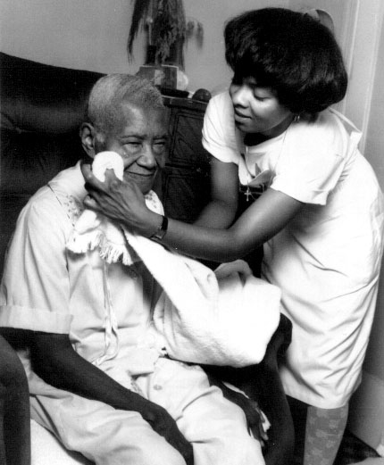

Everyone!
Whether Medical, Nursing, Dietary, Social Services, Activities, etc.:
  Keep your eyes and ears open to residents who might need ACP and a POLST form
Notes:
Tammy

Slide 20
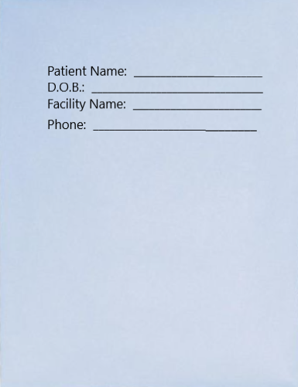

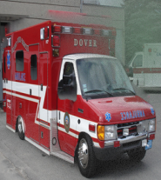



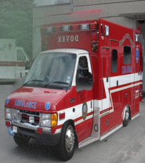
Communication across settings
The health care facility initiating a transfer will send the Transfer Packet and will communicate the existence of the POLST form to the receiving facility prior to the transfer. The POLST form shall accompany the person to the receiving facility and shall remain in effect (just like any DNR form would).
Notes:
Angela
The transfer packet contains vital information for every discipline and caregiver.
Read slide
(scenario-see if current practice) Nurses here may be the one initially sending patient’s in with the orders. You will call 911 and then call report to the Emergency room. At this time, you will let them know the code status and let them know if there is a POLST form that will be traveling with them. When the patient returns, the nurse opens the packet to see if there are new orders from the doctor’s offices or hospital. You may see that a POLST was filled out and will need to be processed like any new order.
Next Slide

Slide 21
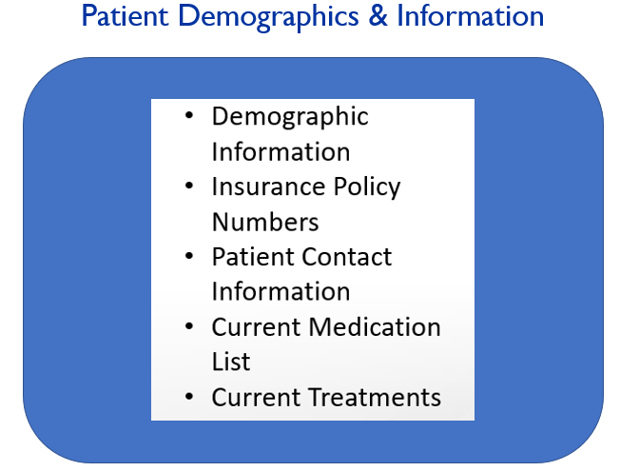
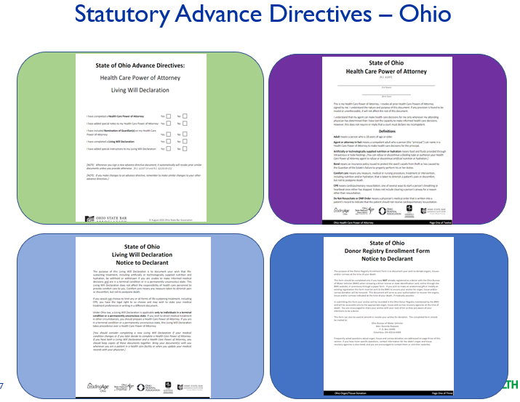
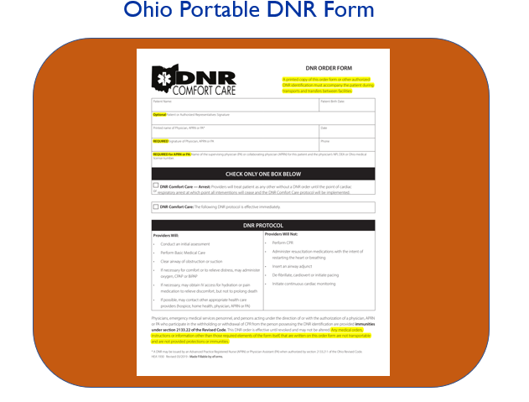
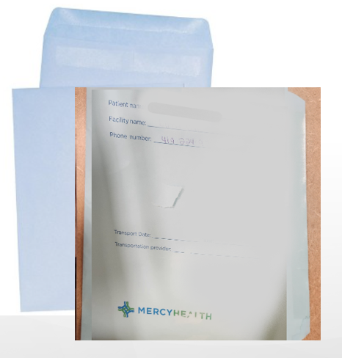
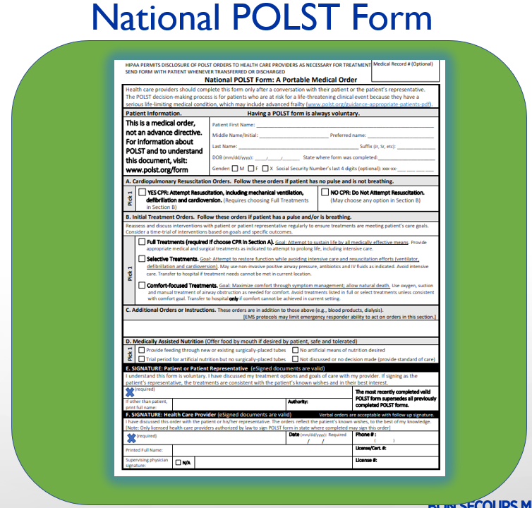
Notes:
Tammy
So now, what goes into the transfer packet????!!!!
Click
Their Advance Directives and portable documents - if any
Click
Their demographic information
Click
Their DNR portable order
Click
Or
Their completed POLST order form Click
All of this goes into one nice, complete, wonderful, well-prepared, TRANSFER PACKET!! - CLICK!!
the goal is that this will travel with them and back! And that this is honored – if you want to hold onto the original they have to make a copy front and back!!!
We will be putting examples of a completed POLST and packet at the nursing stations
Next Slide

Slide 22

Review & Common Questions
What is the current ACP process and what is my role in that process?
Where does the current original copy of the POLST form and other ACP documents go in the chart?
Who may help a resident/POA complete a POLST form?
What do you do if a resident with a POLST form is to be transferred to another health care setting or home with hospice care?
Upon transfer:
  - Call the receiving facility and notify of POLST
  - Make sure a copy of POLST form is in the Advance Directives section of the chart
  Put original copy of POLST form in labeled transfer packet envelope and put on top of transfer
  packet
  Alert EMS/transporter of the POLST form
  Upon return
  When resident returns, ask “Where’s the POLST Form?”!!!!!!
Notes:
Change this – not just about POLST

Slide 23

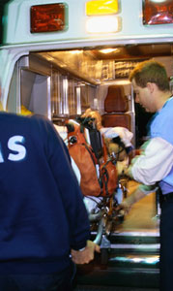
EMS Participants
Shawnee Township
True Blue
Smart Start
Hometown Transports
LACP
RTA
Immunity Concern Addressed
EMS leader quoted OH Division of EMS website
Our response: Facilitator Completes OH DNR if “No CPR” elected in POLST
EMS agreed→ Local Field Operations Manager ordered updated protocols
State Med. Dir. Updated by local manager
Notes:
"From a medicolegal standpoint, the Ohio DNR Comfort Care program is the only form that provides immunity to the Ohio EMS provider as long as the comfort care parameters are followed." In addition, the state Division of EMS website notes that "While the paradigms of physician orders for life-sustaining treatment (POLST) and medical orders for life-sustaining treatment (MOLST) have been initiated in other states; POLST and MOLST programs have not currently been legislated or implemented in Ohio.“ At this time, our EMS providers cannot follow any of the POLST or MOLST forms without a medical control order.

Slide 24


Launch & Progress to Date
←Angela!

Slide 25

All in the Numbers
Pilot Start Date - Week of Nov. 7- 2022
26 Advance Care Planning Conversations Completed
15 Advance Directives completed
6 Code Status changes
12 POLST forms completed – So far two have been acted upon & honored!
Notes:
Diane

Slide 26
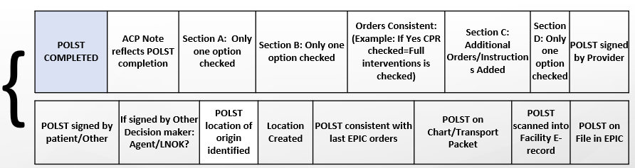
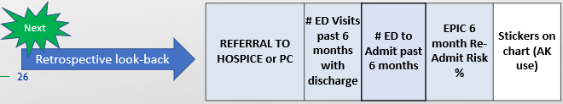
Quality
Tracking Process & Outcomes
Overview & Prioritization
Provider | Primary Diagnosis | # ED Visits past 6 months with discharge | # ED to Admit past 6 months | EPIC End of Life Care Index Score | EPIC Re-admit Risk % | Priority Level | AD on facility chart prior to convo | AD in EPIC prior to convo
Pt Preferences & Outcomes
New AD Created | AD Obtained/Created sent to Medical Records | Code Status Prior to Convo | New Code Status | Date of ACP Convo | Preference for Hospitaliz-ation | ACP Convo in EPIC | ACP Convo in Facility e-Chart

Slide 27
Wins
What’s working well
Education & Awareness: Meeting with Pt/HCDM for ACP opens discussion: “What have the doctor’s told you?” and to address knowledge gaps: Pt with CHF asked, “why on the water pill now”, etc. Grateful for the information and asking questions e.g., when they will know it's time for hospice care.
Code Status: CNP had already approached family about the 99 ½ yr. old family member with a FULL CODE. Daughter & grandchildren were very anxious about the decision. I simply said, “Let's ask your mom”. The patient clearly indicated wanting a DNR initiated. The daughter expressed feeling instant peace. 75- year-old with end stage cancer decided to change his code status to a DNR-CC a week before passing away.
POLST: Medical records is knocking it out of the park getting the POLST forms scanned in.

Slide 28

Challenges
Barriers
Printing/Scanning: Mercy does not allow drivers to be added to their laptops, which would be needed to print documents at Pilot Site. Site’s copier will not scan into the Mercy email. Therefore, there's some driving back and forth to print and scan to get documents to both systems.
Nurse Stations: Each nurse station has transport packets in different locations (by chart, in a drawer, or near charts together). Some patients have more than 1 chart, others I could not locate. The process is to remove all contents from the packet in-between being sent out. Some stations adhere, others leave in the face sheet, code status and orders. DNRs are not always in chart before a patient goes out/or old code status may be present from last trip.
2 Instances where a DNR/POLST has been signed, physician order slip signed to change code status and the EMR read as Full Code a week later, documents not on chart or changed in packets.
Staff turnover/travelers: Even with initial training, there are many new staff members that do not understand the ACP facilitator role. Ongoing teaching occurring.

Slide 29
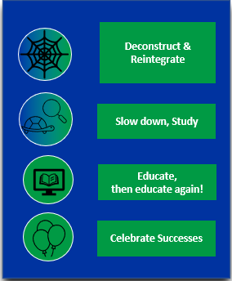
Next Steps
Track 6-month findings
Engage next partner facility
Prepare hand-off to LTC staff for sustainability
Enlist BSMH-specific teams / departments in initiation of POLST
Identify next BSMH market
Notes:
Becky

Slide 30
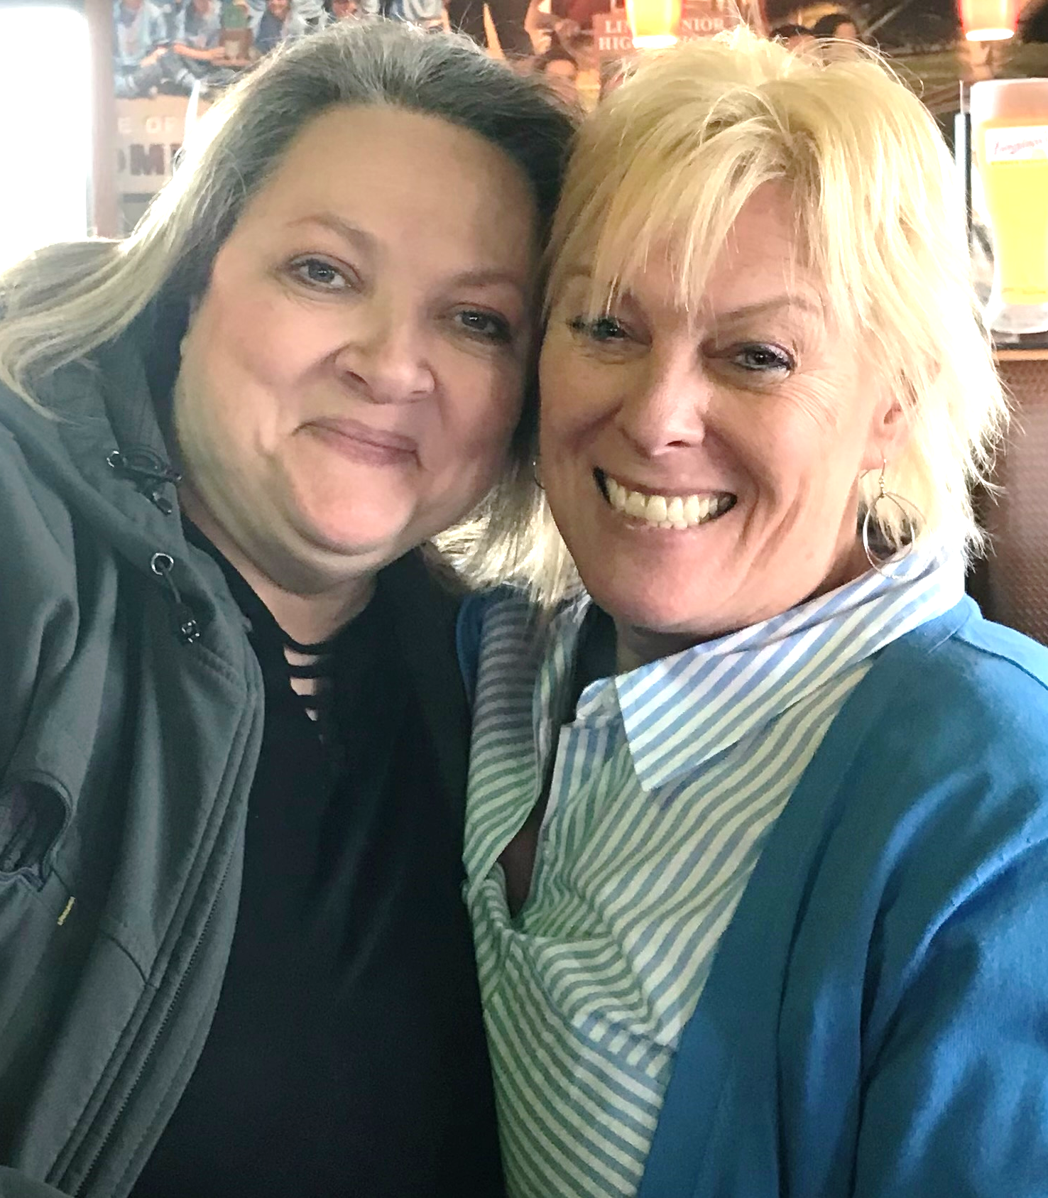
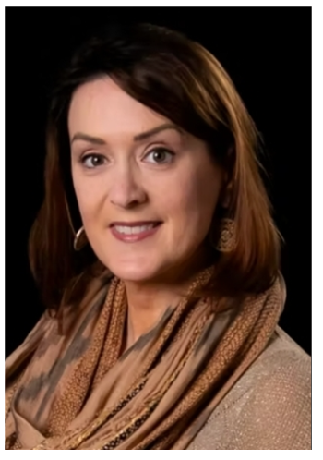
Tips
→ Add POLST pilot to existing program/grant
→ Do friendly site visits
→ Maintain momentum
→ Build a robust team; Anticipate attrition
Milestones of our Journey…Where will Your Journey lead You?

Slide 31
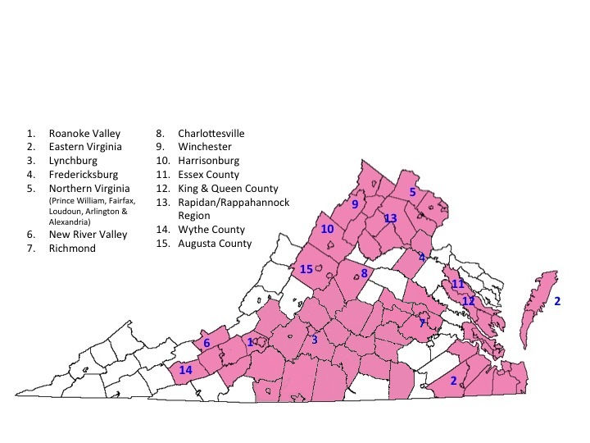

What Difference could We Make if we…
(Virginia POST Collaborative
as of January 2017)
New Branding Feb 2023

Slide 32
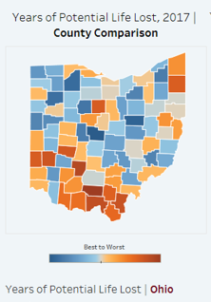
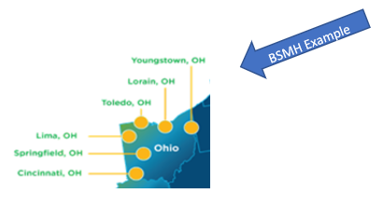
Create Ohio Map for POLST Activity
Starting with Health Systems..
    who are engaged with Leading Age OH or Honoring Wishes?
    who are in the largest population centers?
    who have dedicated Palliative teams?

Slide 33

Let’s Go!
This Photo by Unknown Author is licensed under CC BY-SA

Slide 34
Questions

