Slide 1

Adult Day Impacted Industry Program
Application and Guidelines Overview
Notes:
Thank you, Bobbi
And thank you to all of you joining this webinar today to learn about key DEI concepts and tips and tools to incorporate them into your role as nursing home administrators.

Slide 2

ARPA Adult Day Funding
Jennifer Carlson
Assistant Director, Ohio Department of Aging

Slide 3
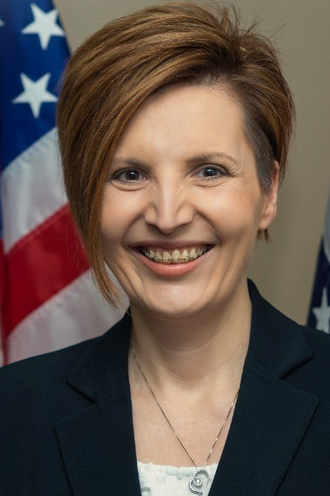

ARPA Adult Day Funding
Stacie L. Massey, MBA, CGFM
Deputy Director, Grants and Financial Reporting
Ohio Office of Budget and Management

Slide 4

Background
House Bill 45
  Passed by OH Senate in December 2022
  Collaboration of Ohio Department of Aging and Ohio Office of Budget and Management
  Funded through Coronavirus State and Local Fiscal Recovery – ARPA Funds
  Adult Day Services- two tranches
    First Tranche: June 2023 Workforce Relief

Slide 5


Susan Wallace President / CEO
Randi Hamill
Workforce Director
LeadingAge Ohio

Slide 6
Adult Day Services, an Impacted Industry
Extended closures through the pandemic
Decrease in ADS participants
  Reduced Staff
  Participants moving to higher level of care
  Transmission concerns for vulnerable individuals
At least 14 ADS facilities closed during the pandemic

Slide 7
House Bill 45 Second ADS Tranche
Designed to build capacity for existing ADS sites
Creation of new ADS sites
  Special attention to geographic areas where services currently do not exist
Application is open and closes on February 2, 2024

Slide 8
Application Requirements
  Must have an Aging Provider Number or apply for one before January 26, 2024
    Find more information on Aging Provider Numbers here.
  Must currently be registered for PASSPORT or have proof of application
    Find more information here.
  Valid Tax ID Number (TIN)

Slide 9
Application Requirements
Demographics and geographic description of the area applicant intends to serve;
Anticipated capacity (# of older adults served, both Medicaid providers and others);
Planned justification of need for expansion or creation of new site in this specific location; and
Total requested amount and use of funds category.

Slide 10
Funding Categories
Industry Restoration Activities
  Expenses to enter/reenter the market or expand existing services
  Examples: equipment, supplies, start-up fees, infrastructure modifications for initial operations
  Not intended for:
    Fully funding the start-up of services
    Real property or large capital purchases
  Costs must demonstrate an increase of individuals served

Slide 11
Funding Categories, Cont.
Industry Revitalization Activities
  Expenses incurred from a currently active provider to increase services
  Costs must demonstrate sustaining future retention
  Examples: Equipment or facility upgrades to accommodate more participants, new technology programs for increased capacity
  Costs funded should not require additional large/unsustainable future funding to sustain

Slide 12
Funding Categories, Cont.
Workforce Impact Activities
  Expenses that directly relate to recruitment and retention of workforce
  Examples: benefits not previously offered, wage increases and bonuses, hiring bonuses, wages for newly hired staff, recruitment costs
  Funds cannot be used to reimburse previously incurred or retro costs, only future costs incurred after funds are awarded

Slide 13
Ineligible Expenditures
Costs unrelated to the pandemic
Cost incurred prior to July 1, 2023
Costs already covered by another source
Non-business expenses
Payment for taxes, fines, political purposes
To satisfy a debt, settlement, or judgement
See full list here.

Slide 14

Reporting Requirements
Reporting will be submitted via OBM’s Ohio Grants Portal following the distribution of funds.
Awardees will be notified via email with reporting access and directions after application approval.

Slide 15
Important Information
The provider that receives the funding must become fully active, remain open and active through December 31, 2026, or will be required to return the funding.
Eligible costs must have occurred between July 1, 2023 and June 30, 2024.
This funding is not “first come, first serve.” All applications will be reviewed at the end of application period.

Slide 16
Important Information, Cont.
A signed Beneficiary Agreement is the only additional document required with the application.
The application does not have to be completed in one sitting.
You may apply multiple times for multiple locations, given that each location has its own TIN.
A Unique Entity Identifier (UEI) is not required for the application.

Slide 17
Next Steps
LeadingAge Ohio is assembling a list of likely applicants for HB45 funds to proactively support them
  Outreach to: Provider Associations, Area Agencies on Aging, County Commissioners, Chamber of Commerce
Weekly “Office Hours”
  Fridays at 11am via zoom
  https://zoom.us/j/4263537852?pwd=dXpKNGk4SzA1Ry9NamMvY05jMGk3UT09; Meeting ID: 426 353 7852

Slide 18
Support and Questions
Randi Hamill, MSW
Workforce Director
LeadingAge Ohio
rhamill@leadingageohio.org
arpaprovider@obm.ohio.gov
Susan Wallace, LSW
CEO / President
LeadingAge Ohio
swallace@leadingageohio.org

